Slide 1
Chapter 6
Worksheet for a Service Business

Slide 2
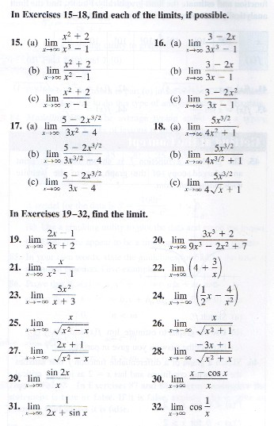
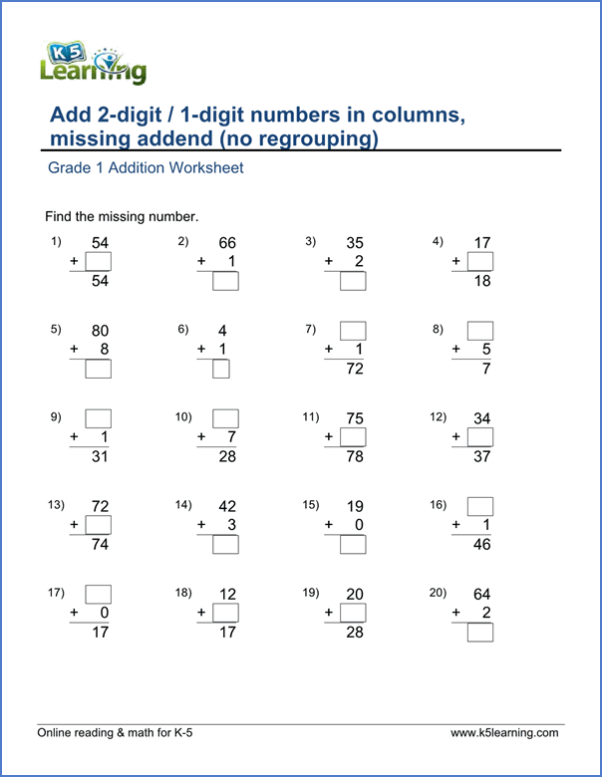
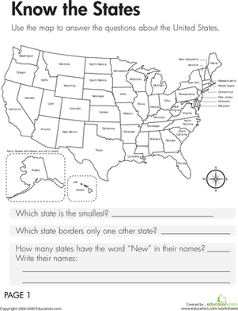
The Worksheet…..
Think of this as a math class. When the teacher hands you an assignment it is called a worksheet, right? Well the thought process is almost the same in accounting.

Slide 3
The importance of a worksheet..
Account Title | Trial Balance |  | Adjustments |  | Income Statement |  | Balance Sheet
 | Debit | Credit | Debit | Credit | Debit | Credit | Debit | Credit
Mr. Prosser’s Poodles
Worksheet
For the month ending October 31, 20xx
A worksheet is simply that it is a document that helps us prepare us for the end of the year. We will do all of the math, bring accounts up to date, and determine net income and loss.
First thing we have to do is name the financial document
Three things go on every document
Name of the business
Name of the financial document
Time that the document is for ( for month/year ending 20xx)

Slide 4
Why make the worksheet?
Account Title | Trial Balance |  | Adjustments |  | Income Statement |  | Balance Sheet
 | Debit | Credit | Debit | Credit | Debit | Credit | Debit | Credit
Mr. Prosser’s Poodles
Worksheet
Worksheet
For the month ending October 31, 20xx
Cash
5718
Petty Cash
100
There are 5 components to making the worksheet.
To make sure the general ledger is in balance
We will go back into the general ledger and write down every account we work with and the balance of each of those accounts to make sure we have balance between debits and credits.
Accts. Rec. – Mr. C
150
Accts. Rec. – Mr. G
100
Supplies
1025
Prepaid Insurance
1200
Accts. Pay. – Mr. E
200
Accts. Pay. – Mr. F
500
Mr. P, Capital
5000
Mr. P, Drawing
625
Income Summary
Sales
3565
Advertising Expense
213
Insurance Exp.
Supplies Exp
Utilities Exp
134
Totals
9265
9265

Slide 5
Account Title | Trial Balance |  | Adjustments |  | Income Statement |  | Balance Sheet
 | Debit | Credit | Debit | Credit | Debit | Credit | Debit | Credit
Mr. Prosser’s Poodles
5 Steps to making a worksheet
Worksheet
Worksheet
For the month ending October 31, 20xx
Cash
5718
Petty Cash
100
We will go back into the general ledger and write down every account we work with and the balance of each of those accounts to make sure we have balance between debits and credits.
We have to bring all of our accounts up to date.
.
Accts. Rec. – Mr. C
150
Accts. Rec. – Mr. G
100
Supplies
1025
125
900
Prepaid Insurance
1200
100
1100
Accts. Pay. – Mr. E
200
Accts. Pay. – Mr. F
500
Mr. P, Capital
5000
Mr. P, Drawing
625
Income Summary
Sales
3565
Advertising Expense
213
Insurance Exp.
100
Supplies Exp
125
Utilities Exp
134
Totals
9265
9265
225
225

Slide 6
Account Title | Trial Balance |  | Adjustments |  | Income Statement |  | Balance Sheet
 | Debit | Credit | Debit | Credit | Debit | Credit | Debit | Credit
Mr. Prosser’s Poodles
5 Steps to making a worksheet
Worksheet
Worksheet
For the month ending October 31, 20xx
Cash
5718
5718
Petty Cash
100
100
.
We will go back into the general ledger and write down every account we work with and the balance of each of those accounts to make sure we have balance between debits and credits.
We have to bring all of our accounts up to date.
Move our numbers across the sheet for our financial documents.
INCOME SUMMAY
Accts. Rec. – Mr. C
150
150
Accts. Rec. – Mr. G
100
100
Supplies
1025
125
900
Prepaid Insurance
1200
100
1100
Accts. Pay. – Mr. E
200
200
Accts. Pay. – Mr. F
500
500
Mr. P, Capital
5000
5000
Mr. P, Drawing
625
625
Income Summary
Sales
3565
3565
Advertising Expense
213
213
Insurance Exp.
100
100
Supplies Exp
125
125
Utilities Exp
134
134
Totals
9265
9265
225
225

Slide 7
Mr. Prosser’s Poodles
Account Title | Trial Balance |  | Adjustments |  | Income Statement |  | Balance Sheet
 | Debit | Credit | Debit | Credit | Debit | Credit | Debit | Credit
5 Steps to making a worksheet
Worksheet
Worksheet
For the month ending October 31, 20xx
Cash
5718
5718
Petty Cash
100
100
.
We will go back into the general ledger and write down every account we work with and the balance of each of those accounts to make sure we have balance between debits and credits.
We have to bring all of our accounts up to date.
Move our numbers across the sheet for our financial documents ( this really step three and four).
INCOME SUMMARY
To Determine our Net Income or Net Loss
Accts. Rec. – Mr. C
150
150
Accts. Rec. – Mr. G
100
100
Supplies
1025
125
900
Prepaid Insurance
1200
100
1100
Accts. Pay. – Mr. E
200
200
Accts. Pay. – Mr. F
500
500
Mr. P, Capital
5000
5000
Mr. P, Drawing
625
625
Income Summary
Sales
3565
3565
Advertising Expense
213
213
Insurance Exp.
100
100
Supplies Exp
125
125
Utilities Exp
134
134
Totals
9265
9265
225
225
572
3565
8693
5700
Net Income
2993
2993

